Slide 1


Methods for detecting trait-dependent diversification
Benedict King
Postdoc, Naturalis Biodiversity Center

Slide 2
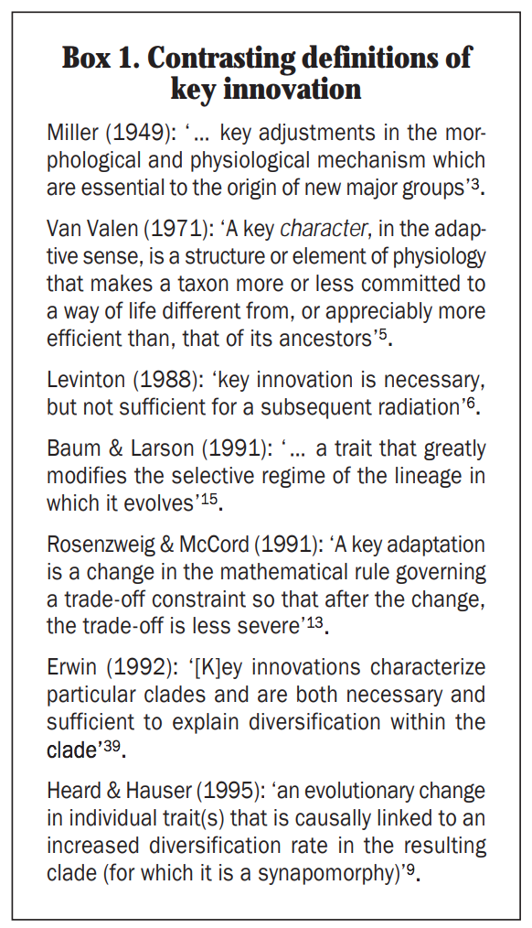
Key innovations
An important concept in evolutionary biology
The definition of a key innovation has changed through time.
Recent definitions have focused on increased diversification rates
However this discounts some adaptations (such as the human brain) from being key innovations
Convincing evidence for a key innovation should include both comparative evidence for increased diversification and a plausible mechanism

Slide 3
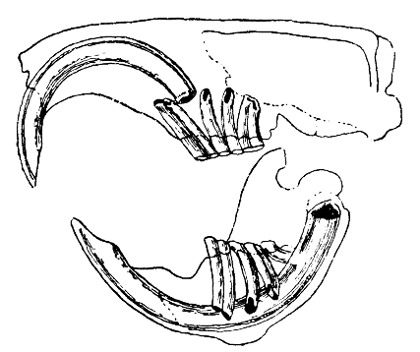
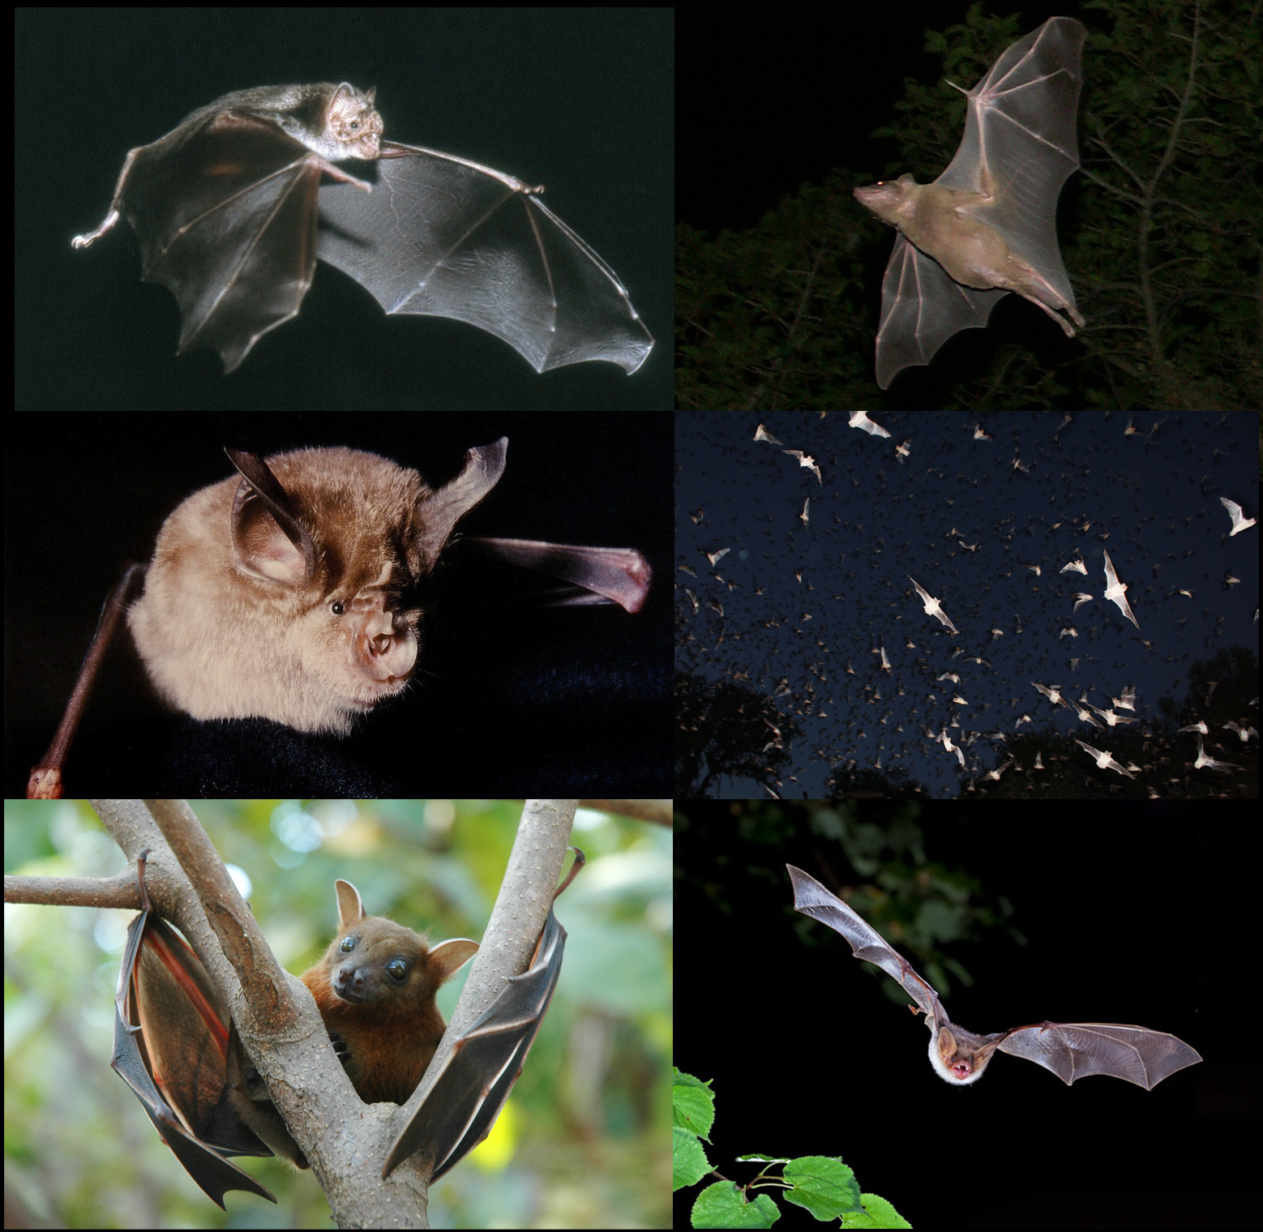
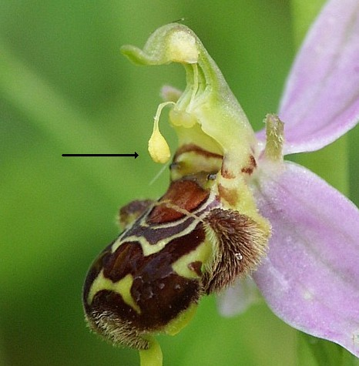
Types of key innovation
2. adaptations that increase fitness
e.g. continuous incisor growth in rodents
adaptations that allow invasion of a new adaptive zone
e.g. flight
3. adaptations that promote reproductive isolation
e.g. Pollinia in orchids

Slide 4
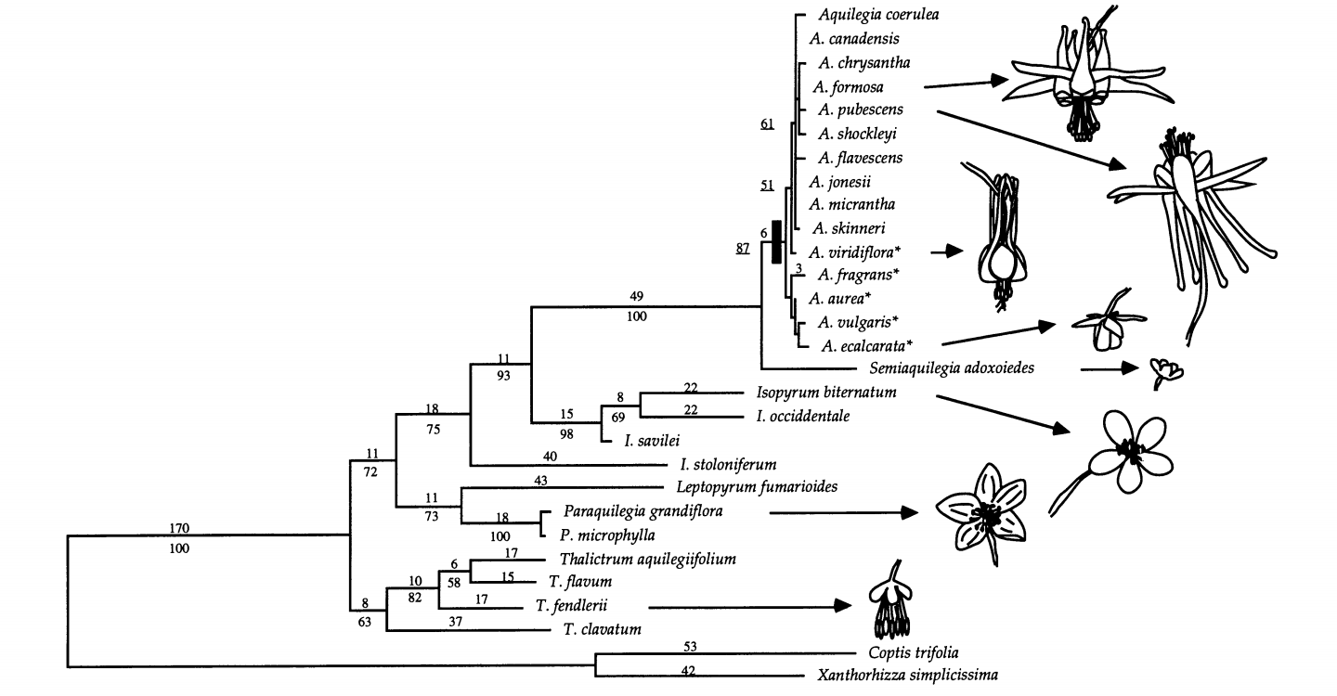
Sister clade constrasts
Compare species richness of clades containing the trait of interest with their immediate sister groups
Each clade is the same age as its sister group
Nectar spurs are a key innovation in flowering plants (Hodges 1997)
Nectar spurs present
Nectar spurs absent

Slide 5
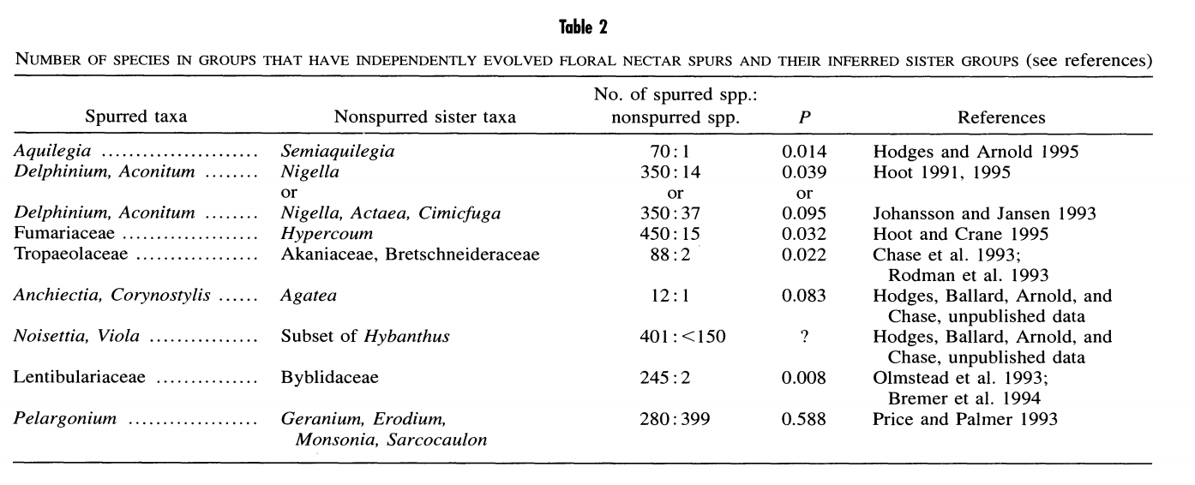
Sister clade constrasts
Comparing multiple groups with a trait to their sister groups
Are groups with the trait more diverse compared to their sister groups than expected by chance?
yes
no

Slide 6
Problems with sister-clade constrasts
Cannot tell if the pattern is caused by different speciation or extinction
Throws away a lot of information by only considering sister clades

Slide 7
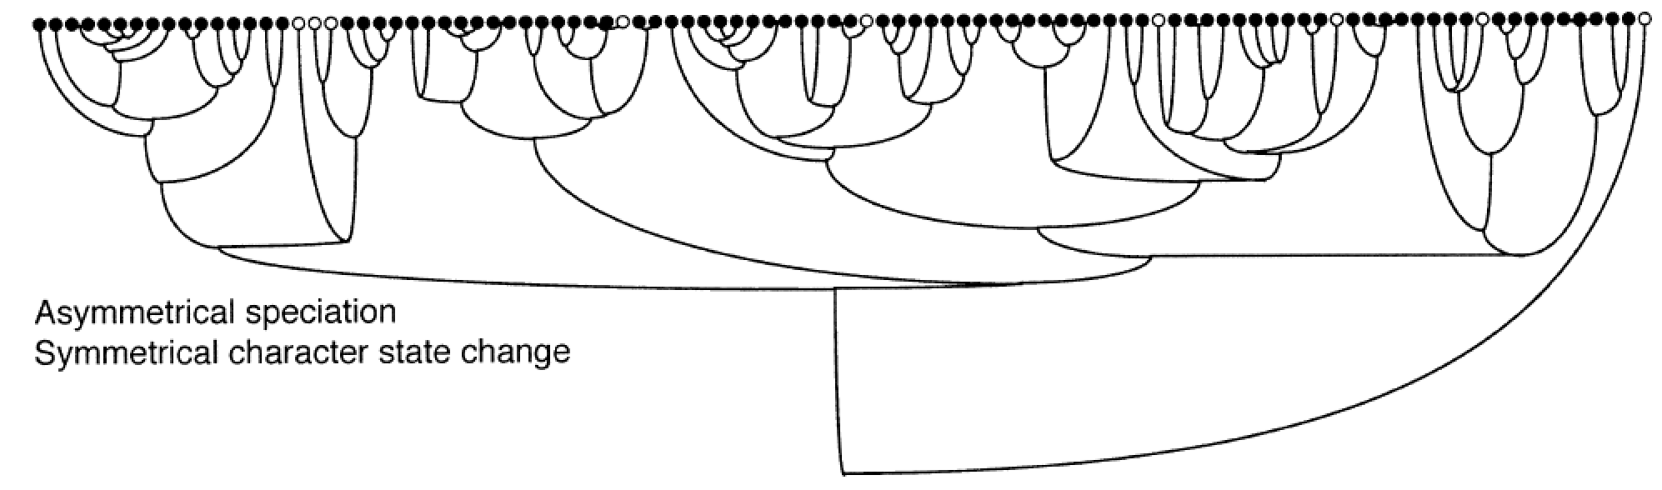
Problems with sister-clade constrasts
An increased diversification rate for state 1 would produce a pattern in which state 0 is rare and state 1 is common
State with fast speciation
Simulation results
State with slow speciation
Maddison 2006

Slide 8
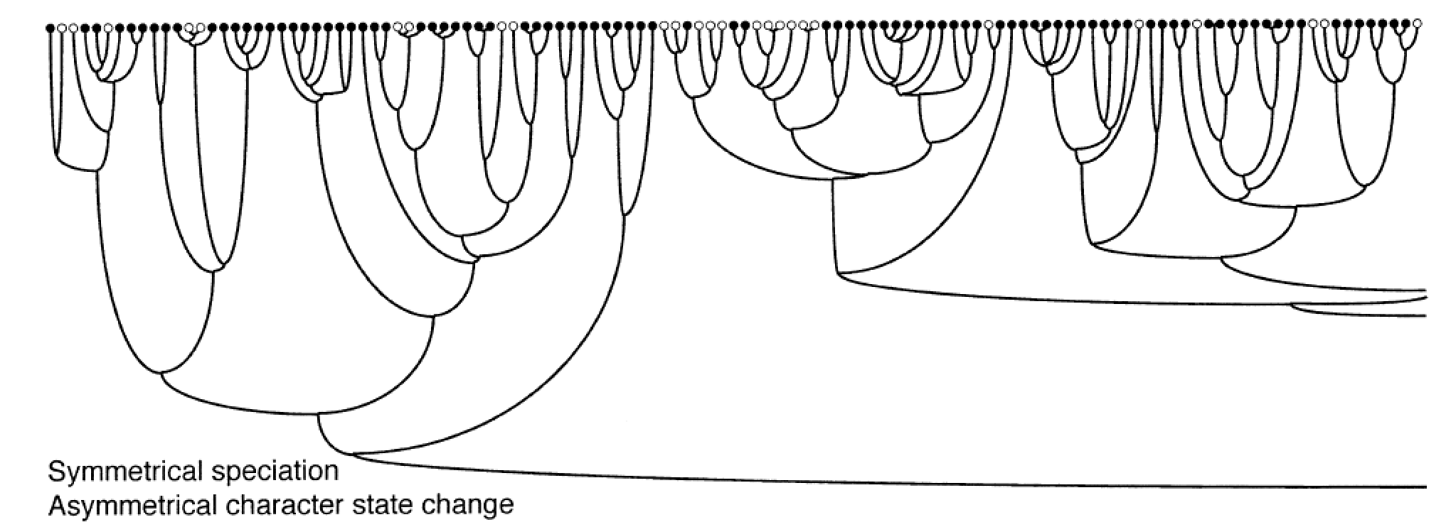
Problems with sister-clade constrasts
The same pattern is produced by different transition rates between states
fast
slow
Maddison 2006

Slide 9
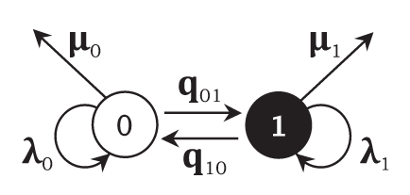
Binary state speciation and extinction (BiSSE)
Avoids the confounding effects of diversification rate and character state changes. Can be used to study both
Based on a model of evolution
The model has two states (0 and 1)
Each state has a speciation (λ0, λ1) and extinction parameter (μ0, μ1)
There are also transitions between states

Slide 10
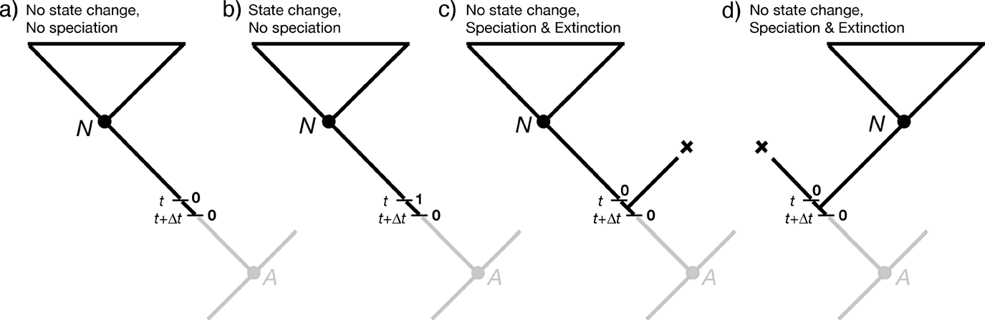
BiSSE likelihood search
The BiSSE algorithm calculates the probability of the tree and the traits for a range of parameter values
The parameter values with the maximum likelihood are found
The likelihood search can be inefficient and may not find the true maximum likelihood estimate

Slide 11
BiSSE model testing
The 6 parameter model for BiSSE must be compared to simpler models
For each model the maximum likelihood is calculated
Trait independent diversification
Trait dependent diversification
Diversification rate
Diversification rate
λ
μ
λ
μ
0
0
state
state
1
1

Slide 12

BiSSE model testing
Find the best fit model without “overfitting”
Akaike information criterion (AIC) or likelihood ratio tests can be used to choose the model
AIC = 2 x (number of parameters) – 2 x ln(likelihood)
Penalty for number of parameters
Raw model fit

Slide 13
BiSSE model testing
Trait independent diversification
Trait dependent diversification
Diversification rate
Diversification rate
λ
μ
λ
μ
☒
✔
0
0
state
state
1
1
Log likelihood -680.6
Log likelihood -680.5

Slide 14
BiSSE model testing
Trait independent diversification
Trait dependent diversification
Diversification rate
Diversification rate
λ
☒
μ
λ
μ
✔
0
0
state
state
1
1
Log likelihood -680.6
Log likelihood -667.2

Slide 15
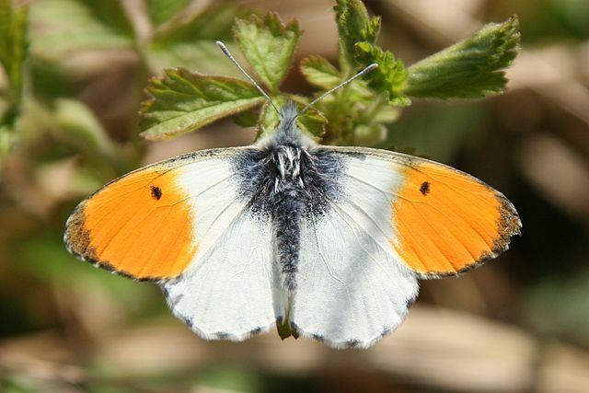
BiSSE method limitations
Possibly another character with the same distribution is affecting the diversification rate
This is less likely if there are many origins of the character
Ditrysia - 98% of butterfly and moth species.
Major synapomorphies include the separation of the tracts for egg-laying and mating and a reorganisation of the renal system
Which trait is responsible for diversification?

Slide 16
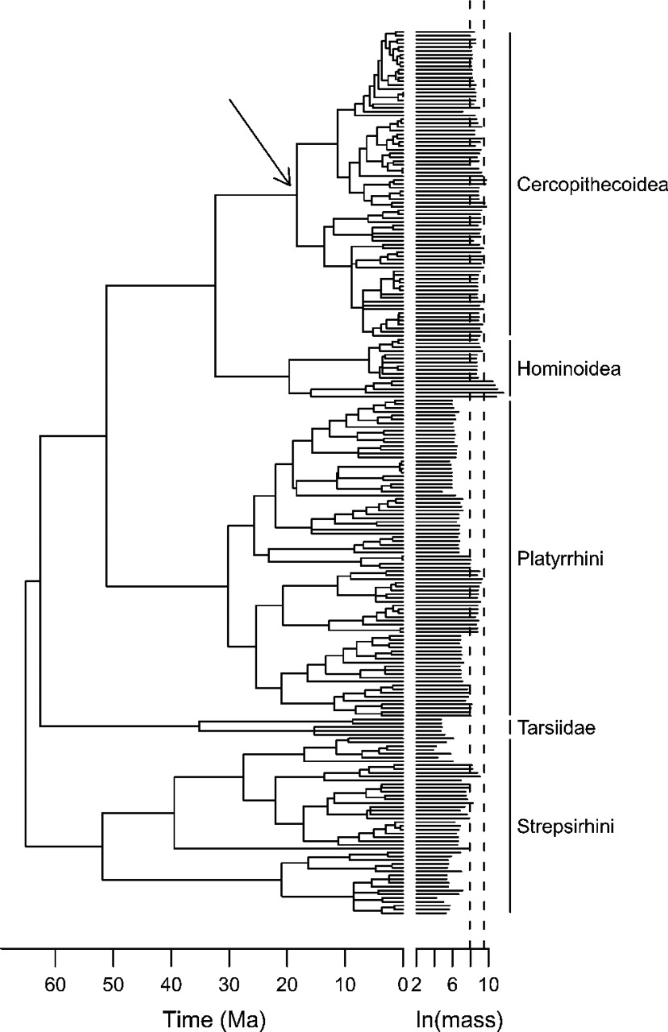
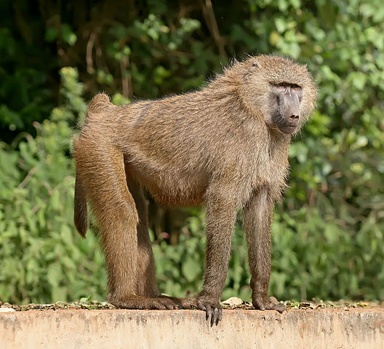
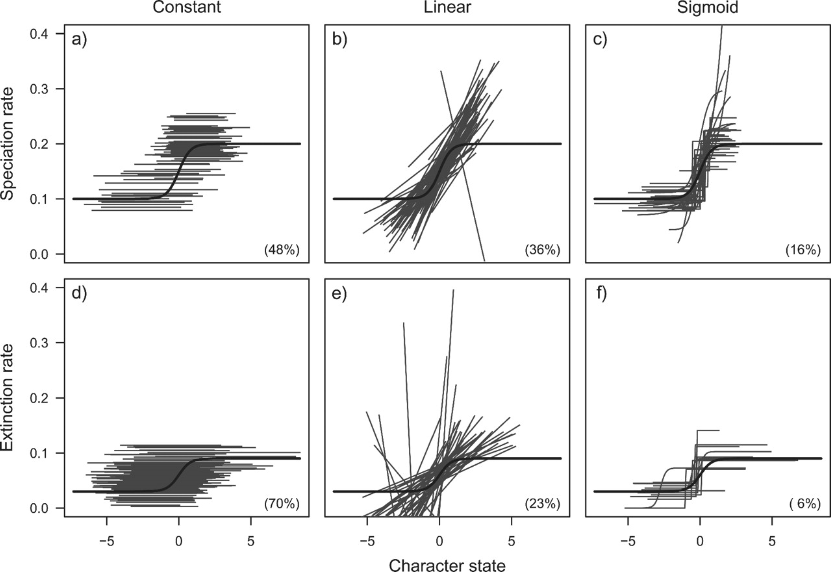
BiSSE extensions
QuaSSE – continuous characters
Can be used to test the effect of body size on diversification rates
Fitzjohn 2010

Slide 17
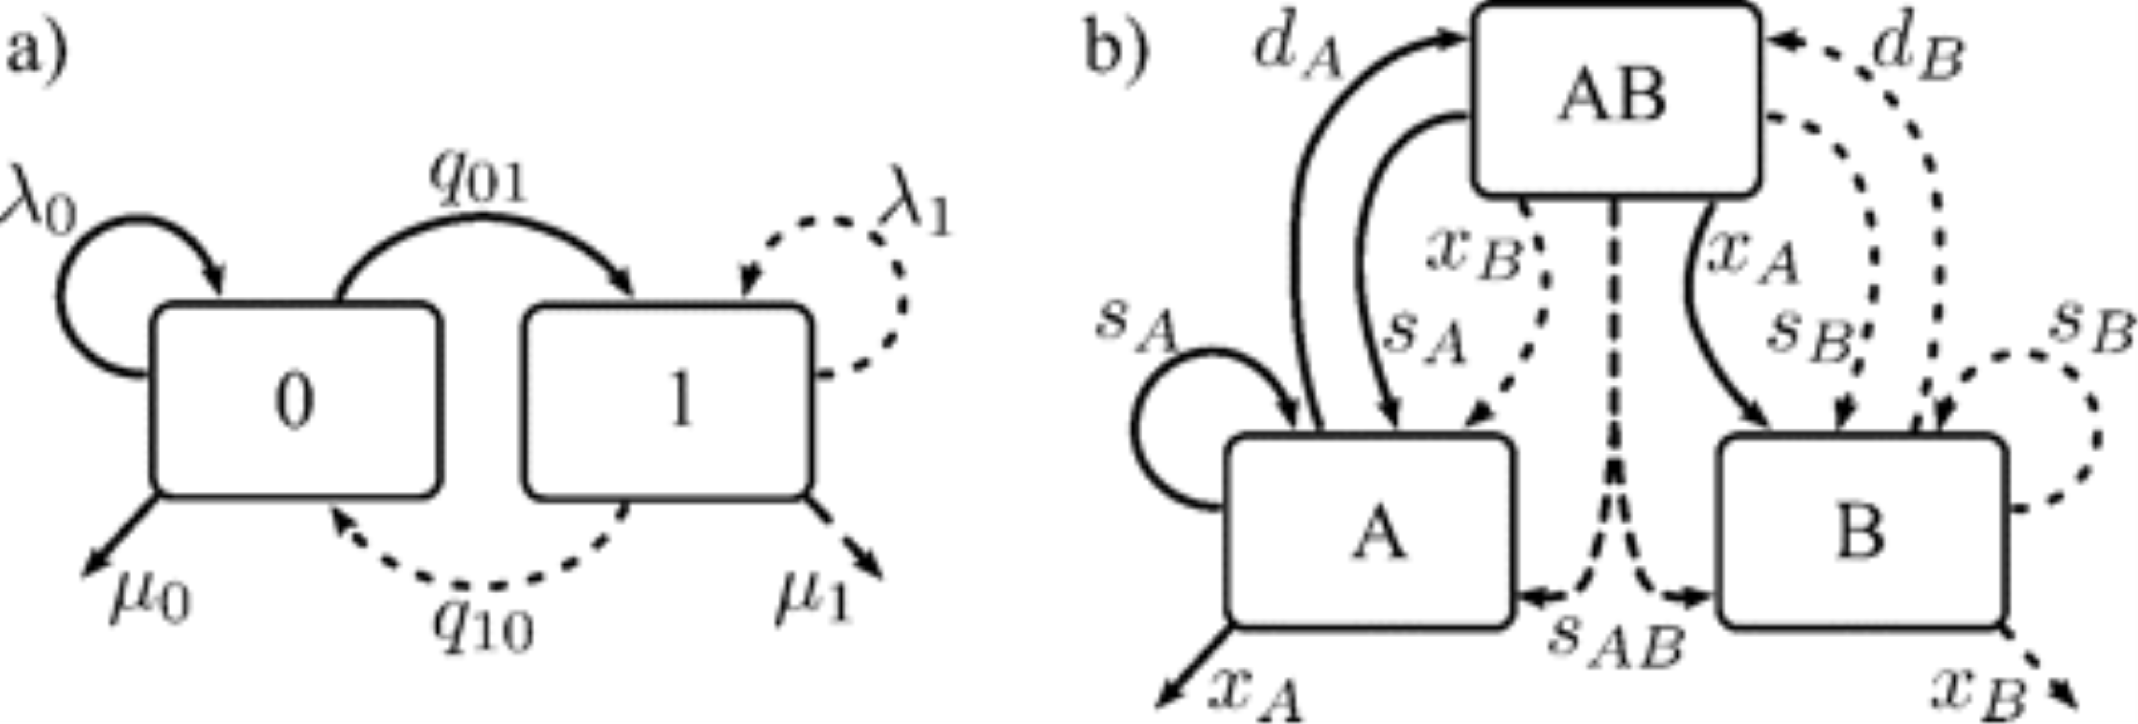
GeoSSE – geographic regions
BiSSE extensions
BiSSE
GeoSSE – includes an additional state AB (present in both regions), and additional speciation parameter (a species in AB splits into two, one in A and one in B)
Goldberg 2011

Slide 18
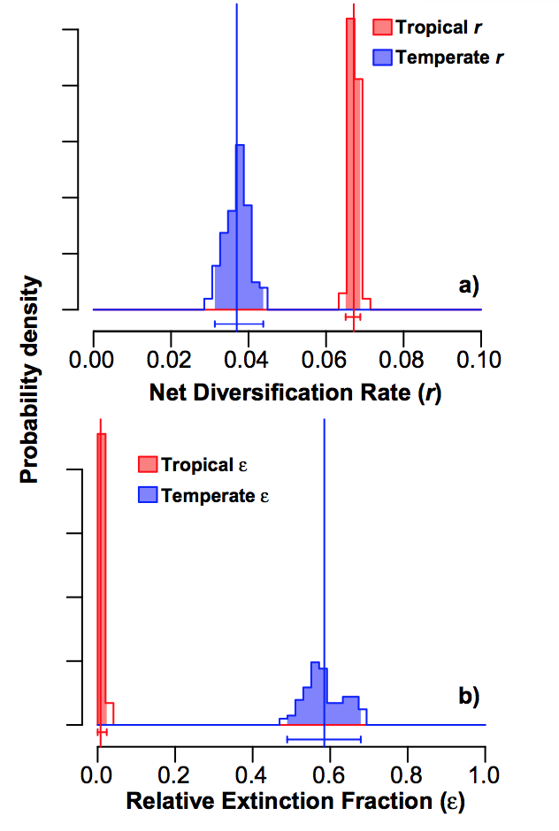
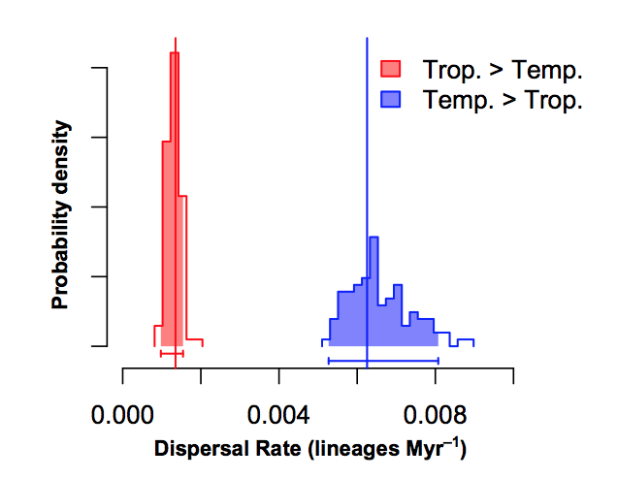
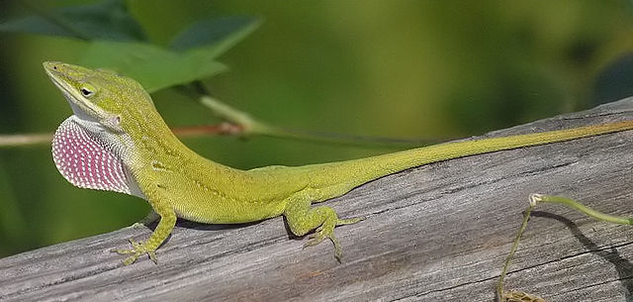
GeoSSE to test the causes of latitudinal diversity gradients in squamate reptiles
Pyron 2014

Slide 19
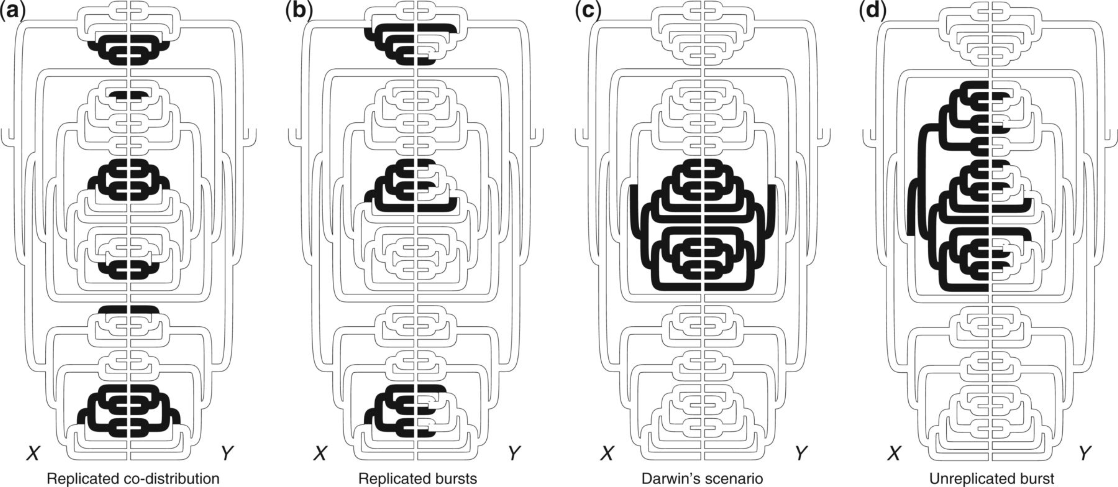
Problems with BiSSE – phylogenetic pseudoreplication
Maddison and Fitzjohn 2015
A and B show good evidence for a correlation between traits. C and D do not

Slide 20
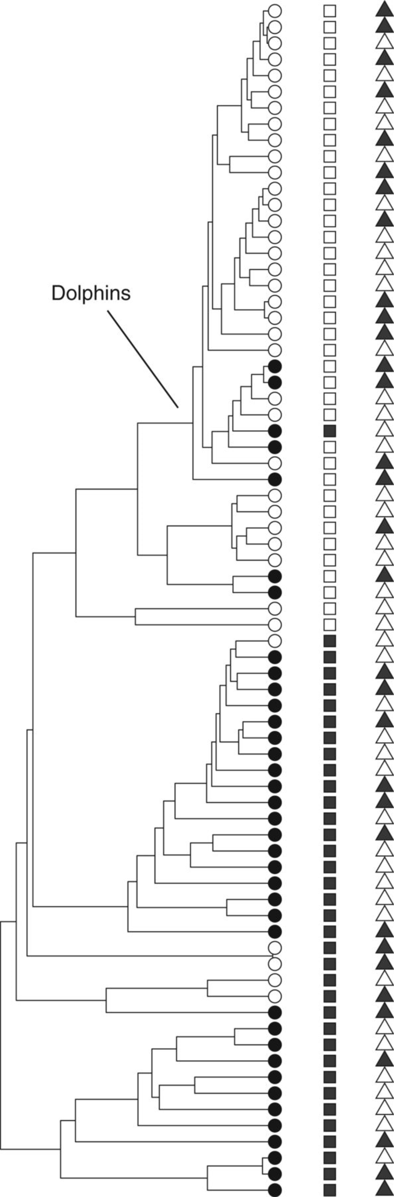
Problems with BiSSE – false positive results (type I errors?)
According to BiSSE, small body size promotes diversification in dolphins
Simulate neutral characters i.e. with no correlation with speciation rates
Run BiSSE
77% of analyses returned a positive association
Particularly problematic when there are low numbers of transitions between character states
However, false positives still occur at when there are many transitions
small
large
Simulation
Rabosky and Goldberg, 2015

Slide 21
Problems with BiSSE – false positive results
These are not type I errors. A type I error is when the null model is correct but the alternative model is supported
In BiSSE the null model is constant diversification
The problem with BiSSE is that it only allows diversification rates to vary with the traits. But life is rarely so simple
This is model inadequacy
Diversification rate
Diversification rate
Diversification rate
λ
μ
λ
μ
λ
μ
0
0
0
state
state
state
1
1
1
Null model
Alternative model (BiSSE)
Real model

Slide 22
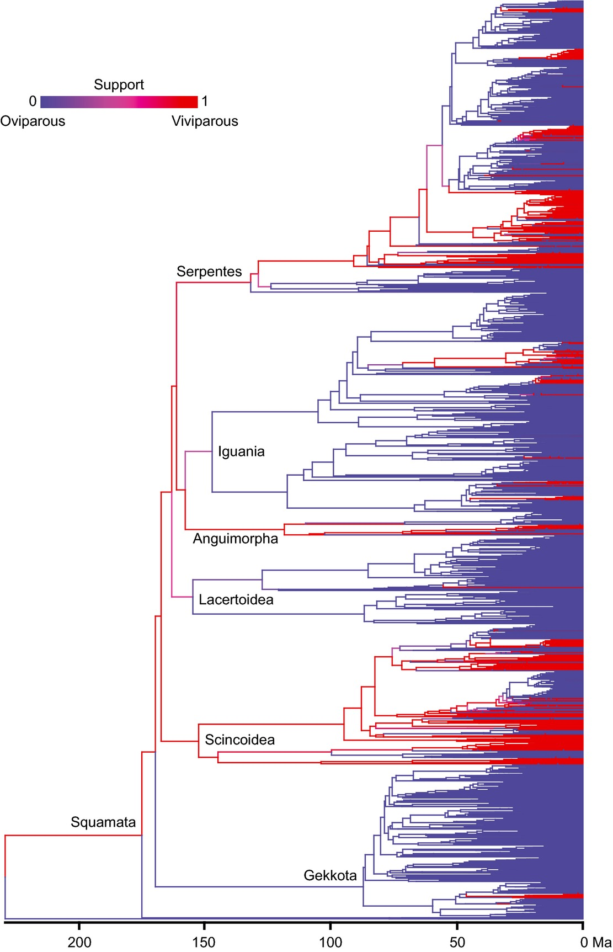

Unusual ancestral state reconstructions
Using BiSSE, strong support for viviparity as the ancestral state for lizards, with egg –laying evolving multiple times
Result is counter to knowledge of biology
Strong support at the root of the tree is counter-intuitive because there are three successive egg-laying outgroups
Pyron and Burbrinck, 2014

Slide 23
Unusual ancestral state reconstructions
Most changes occur in particular parts of the phylogeny
BiSSE (and models in general) assume a single rate of evolution across the tree

Slide 24
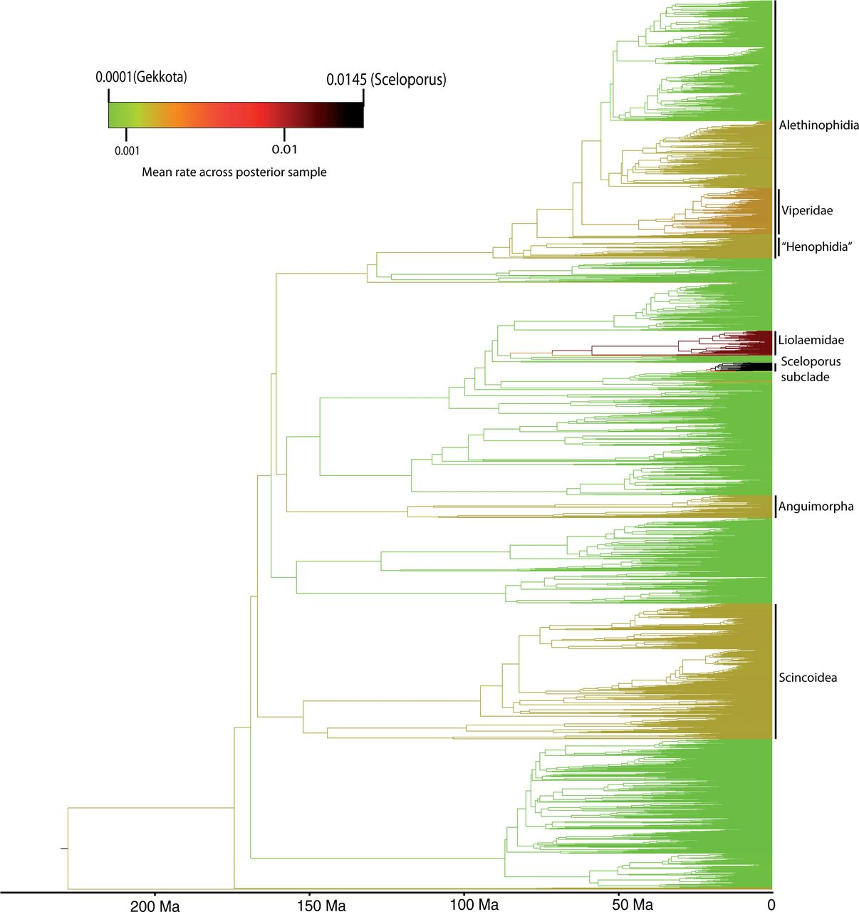
“Random local clock” methods allow different rates in parts of the tree
Most changes occur in particular parts of the phylogeny
BiSSE (and models in general) assume a single rate of evolution across the tree
King and Lee, 2015

Slide 25
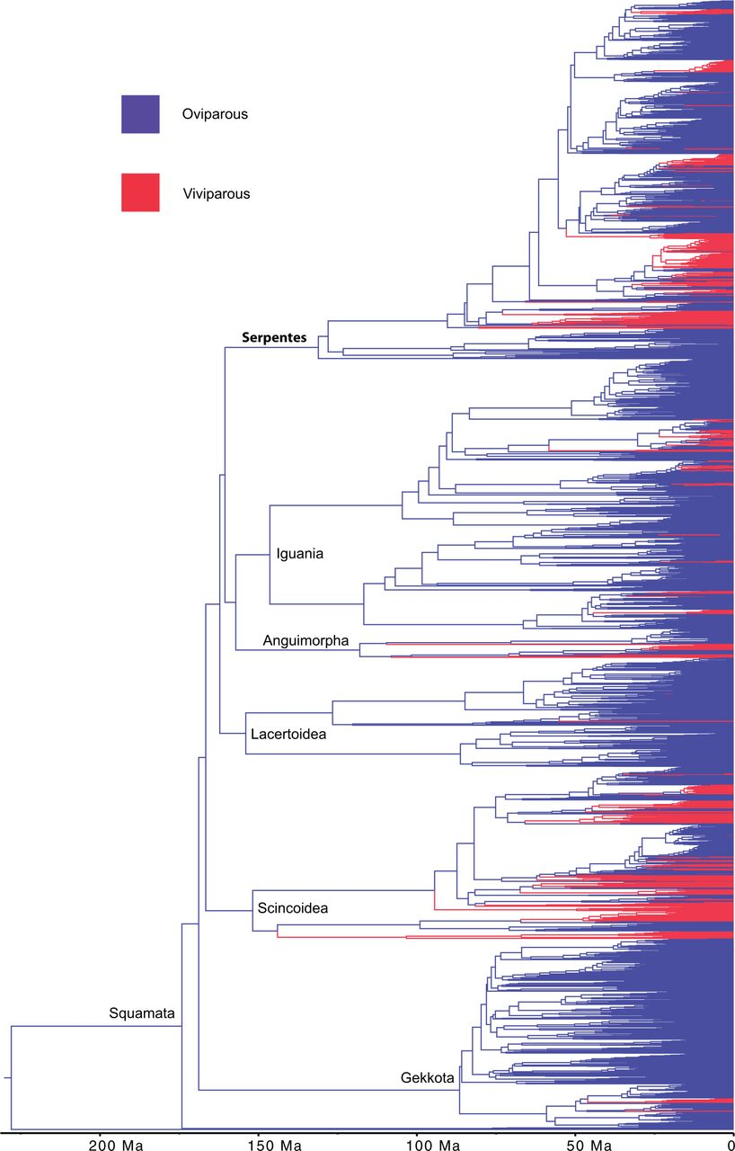
“Random local clock” methods allow different rates in parts of the tree
Produce strong support for oviparity as the ancestral state, in total contrast to models that do not incorporate rate heterogeneity
King and Lee, 2015

Slide 26
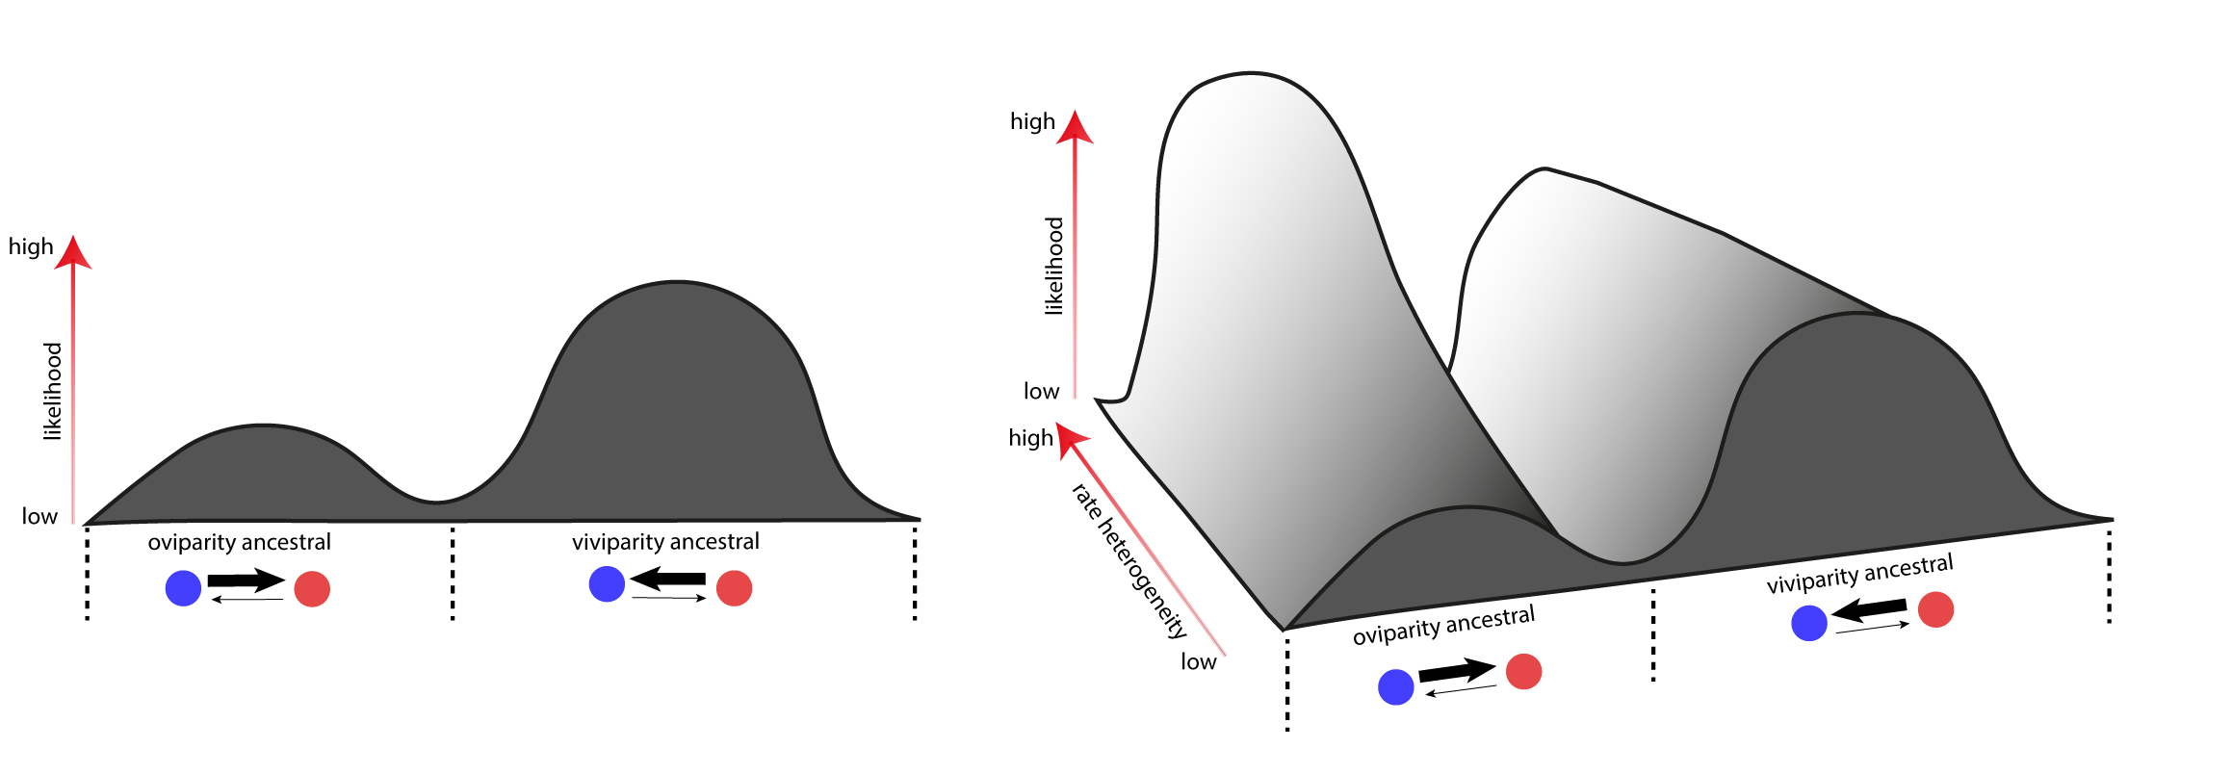
The likelihood landscape
Viviparity as the ancestral state has a higher likelihood peak
However, we have restricted ourselves to a region of the likelihood landscape in which rates are the same across the whole tree

Slide 27
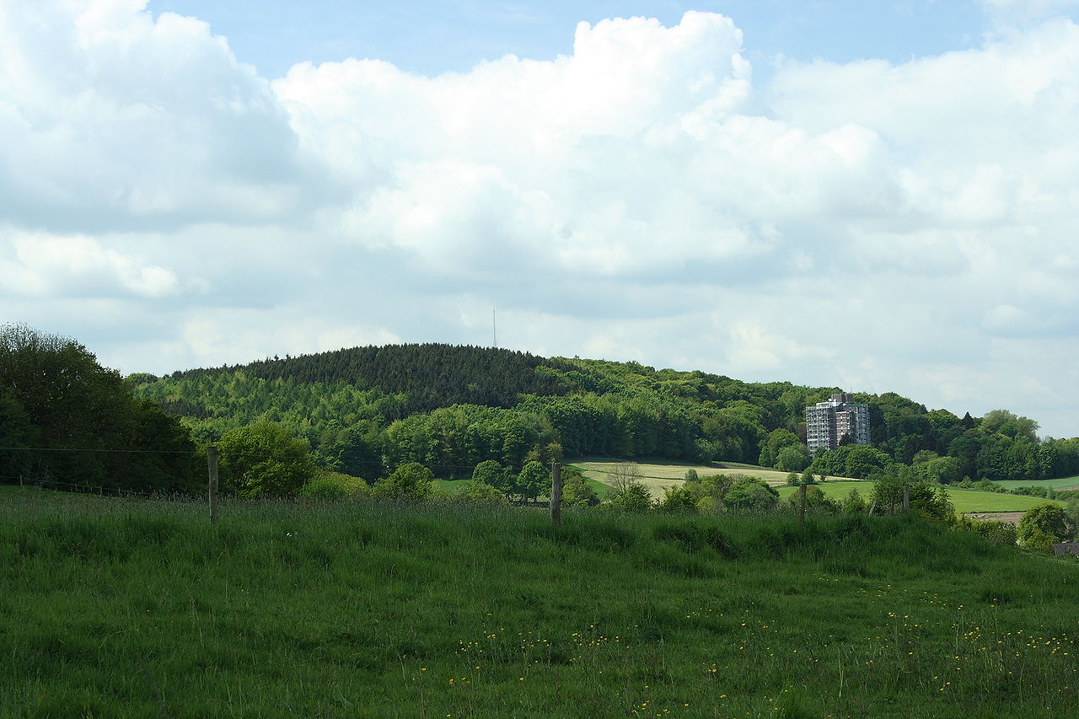
If you never leave the Netherlands, this might look like a mountain

Slide 28
Processes that are not included in the model can lead to “parameter hijacking”
State 0
Rate 1
State 1
Rate 2
Modelled processes
rates
Un-modelled processes
clades
states

Slide 29
Parameter hijacking
1. Generate rate heterogeneity
3. Place state with rapid rate in the clades with rapid rates
4. Bias in rates is so high that an ancestral state of the state with the rapid rate is strongly supported
RESULTS:
THE ANCESTRAL STATE RECONSTRUCTION IS A MEANINGLESS ARTIFACT
INCORRECT ESTIMATION OF TRANSITION RATE ASYMMETRY I.E. HIGH RATE OF REVERSALS

Slide 30
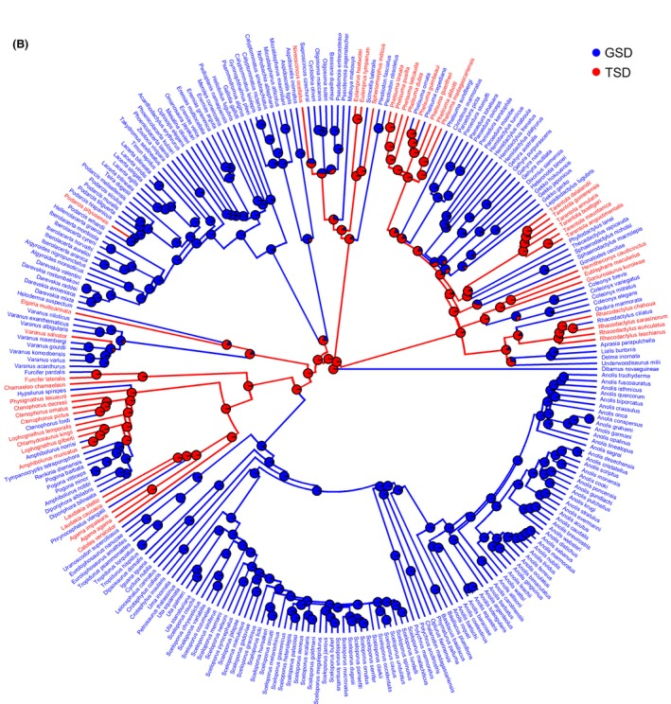
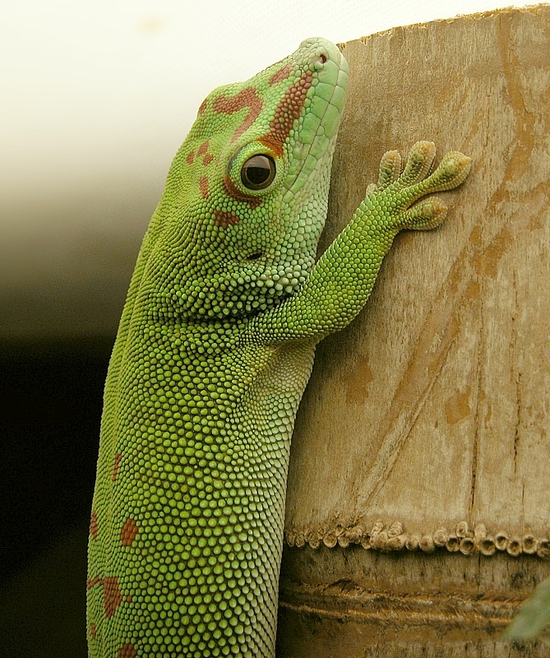
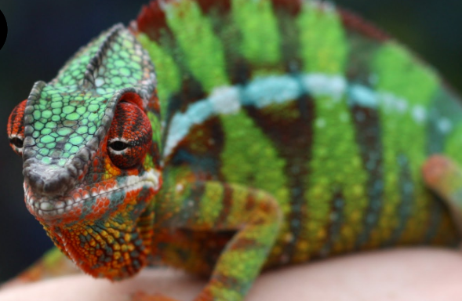
A common problem?
Scincoidea
Gekkota
Is temperature-dependent sex determination the ancestral state for reptiles?
Chamaeleontiformes
Sabath et al. 2016

Slide 31
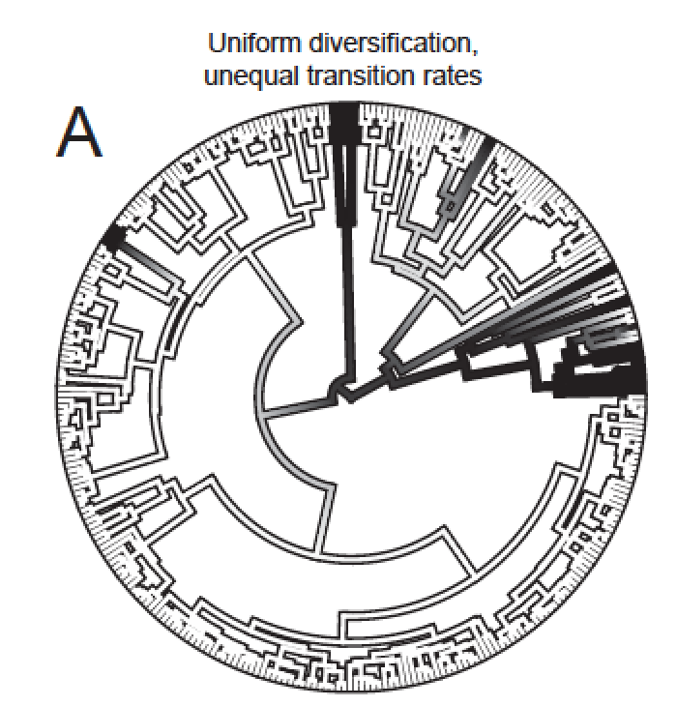
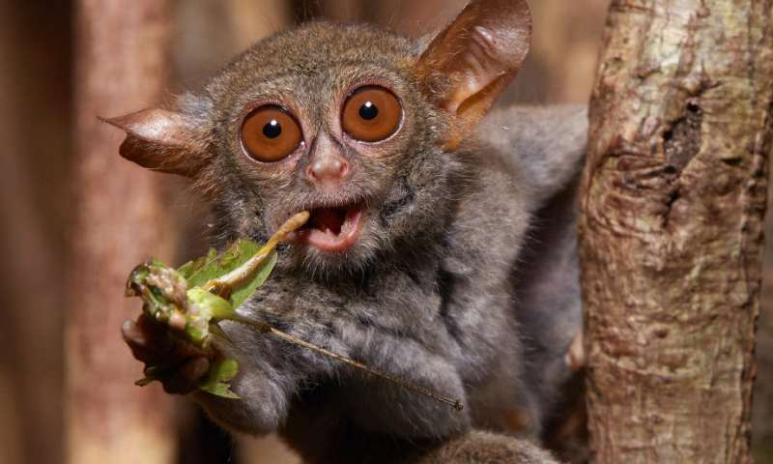
A common problem?
Lorisiformes
Is insectivory (rather than herbivory) the ancestral state for primates?
Scott 2019

Slide 32
“Parameter hijacking” may affect BiSSE
State 0
Rate 1
State 1
Rate 2
Modelled processes
Un-modelled processes
Transition rates
Div. rates
clades
states

Slide 33
Hidden state models can improve model adequacy
State 0
State 1
OBSERVED
HIDDEN STATES
HIDDEN STATES
State 0A
State 0B
State 0C
State 1A
State 1B
State 1C
MODEL
DIVERSIFICATION RATE
DIVERSIFICATION RATE

Slide 34
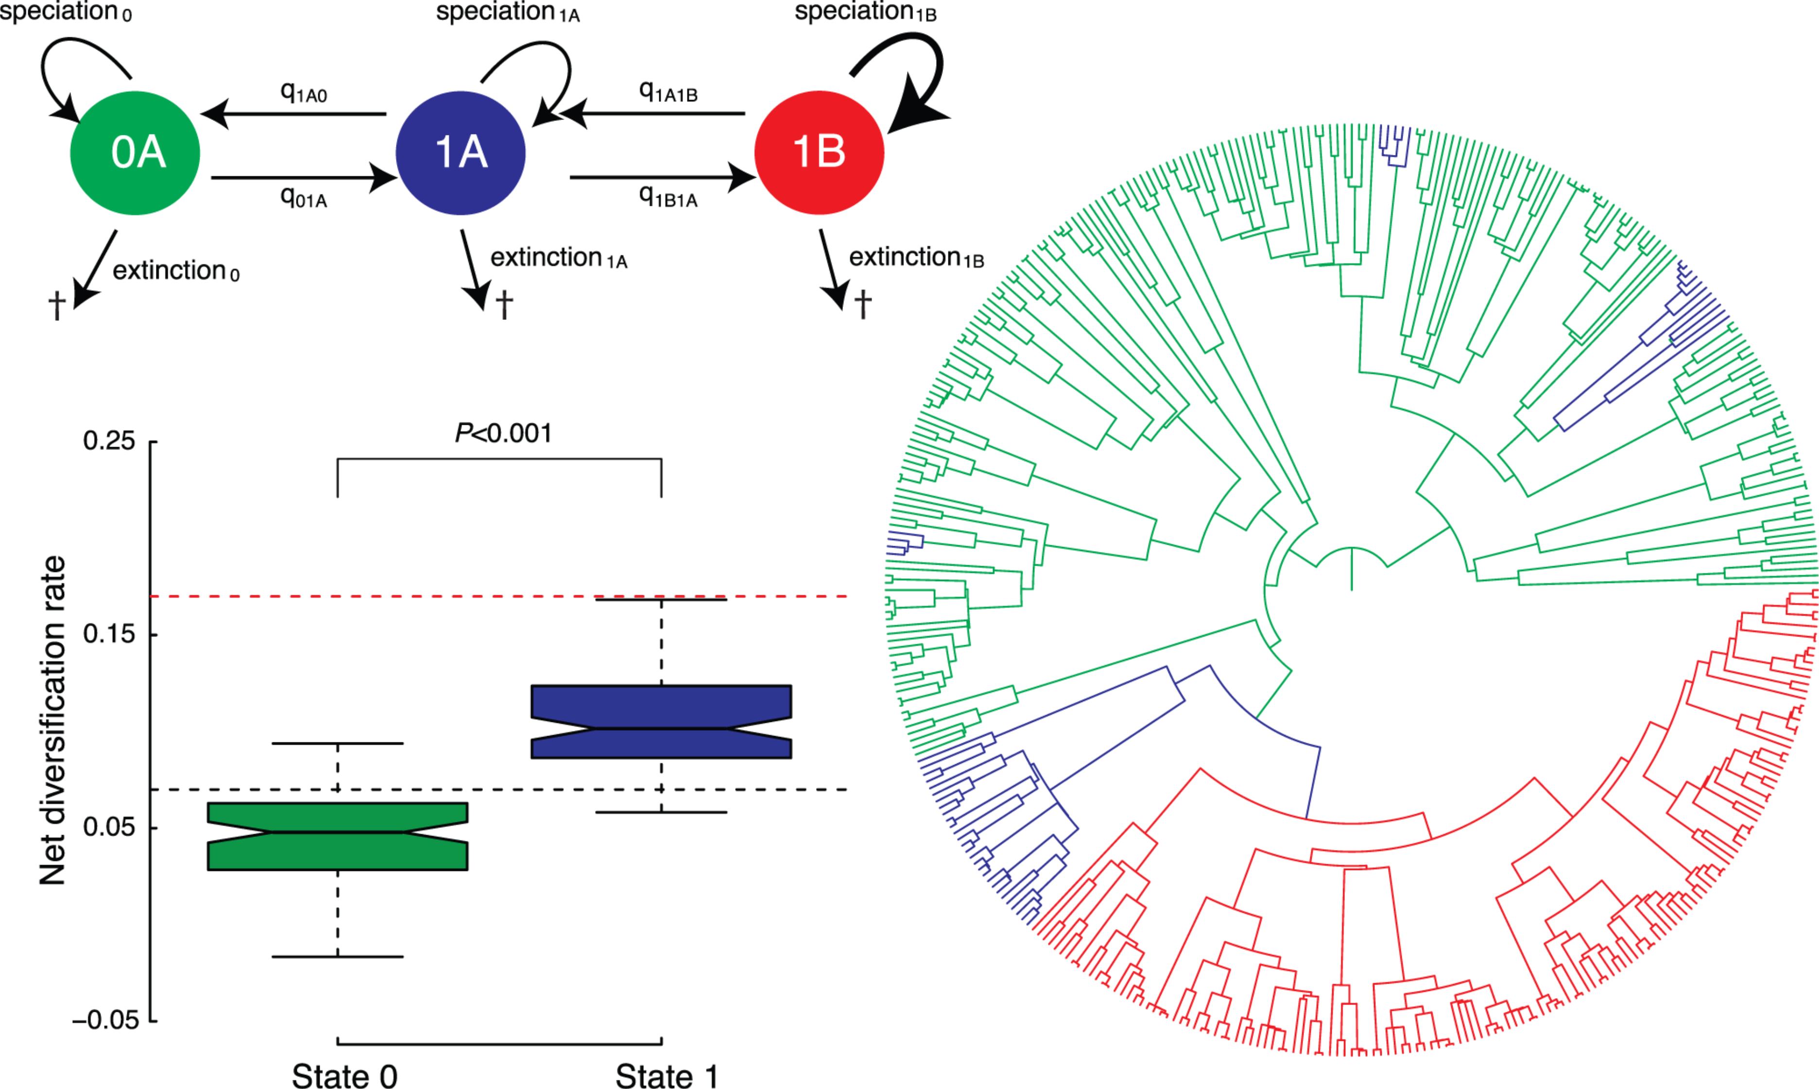
HiSSE – hidden state speciation and extinction
Incorporates the possibility of unobserved processes affecting diversification
Beaulieu and O’Meara 2016

Slide 35
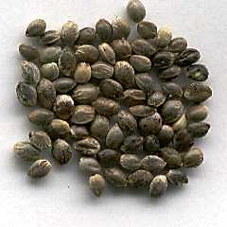
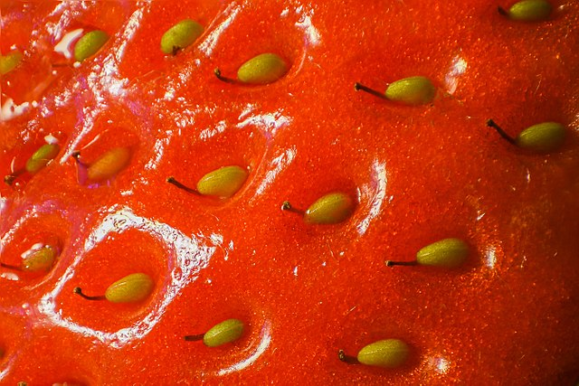
HiSSE example - Do achene fruits promote diversification

Slide 36
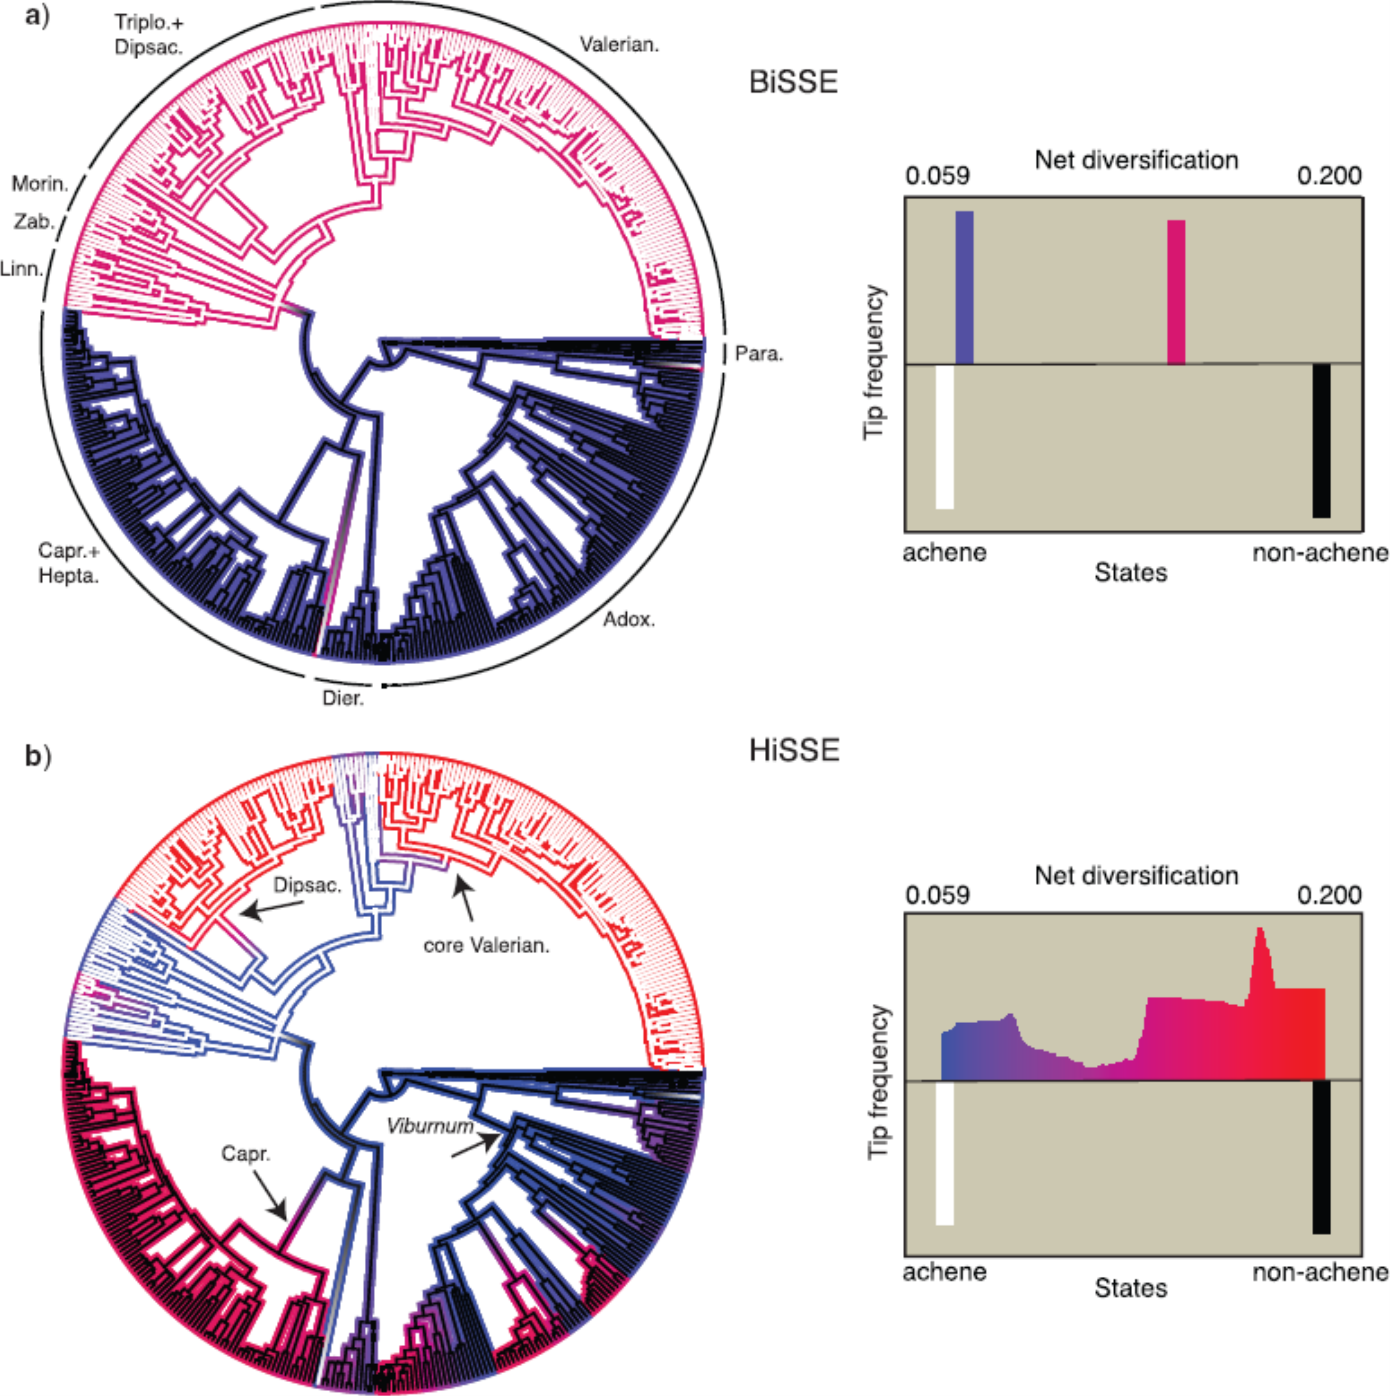
BiSSE suggests achene fruits promote diversification
HiSSE reveals a complex pattern of diversification rates

Slide 37
Hidden state models can be used to construct appropriate null models for BiSSE
BiSSE might be supported over a null model without state dependent diversification simply because it contains at least some diversification rate heterogeneity
A better comparison is to a model which contains the same amount of diversification rate heterogeneity, but where this is not linked to the traits
Diversification rate
Diversification rate
Diversification rate
λ
μ
λ
μ
λ
μ
0A
0
0
0B
state
state
state
1A
1
1
1B
Standard null model
Alternative model (BiSSE)
Null model with hidden states

Slide 38
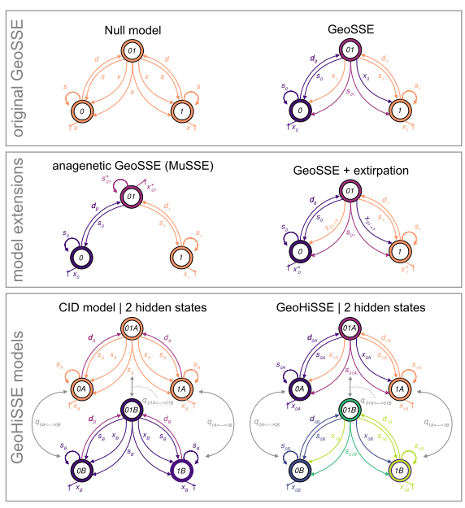
GeoHiSSE
An extension of GeoSSE with hidden states

Slide 39
Non-parametric and semiparametric methods
HiSSE is still susceptible to phylogenetic pseudoreplication
Non-parametric methods have been developed to be used as additional tests
These methods calculate diversification rates without considering character states, then look for correlations

Slide 40
FiSSE – a nonparametric method
First calculates diversification rates without considering the characters
Inverse equal splits measure is a simple estimate of diversification rate

Slide 41
FiSSE – a nonparametric method
Caculates mean diversification rate of state 0 and state 1
The difference in mean is the test statistic
Calculate mean diversification rate in state 0
Calculate mean diversification rate in state 1

Slide 42
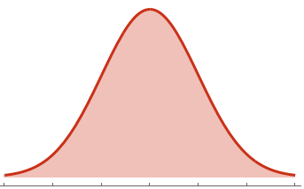
FiSSE – a nonparametric method
Simulate random characters on the same tree
Calculate the same test statistic for each of these
Observed
character
Simulated
characters
Test statistic

Slide 43
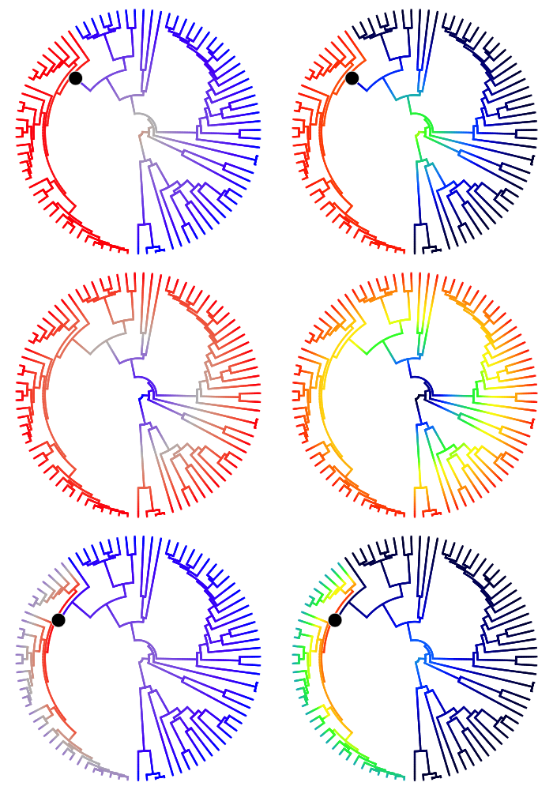
STRAPP – a semi-parametric method
First diversification rates are estimated without considering characters, using a program called BAMM
BAMM splits the tree into a number of discrete blocks, each with a diversification rate “regime”
BAMM produces a set of trees with assigned rate regimes
If a particular rate regime appears in most of this sample, then it has strong support

Slide 44
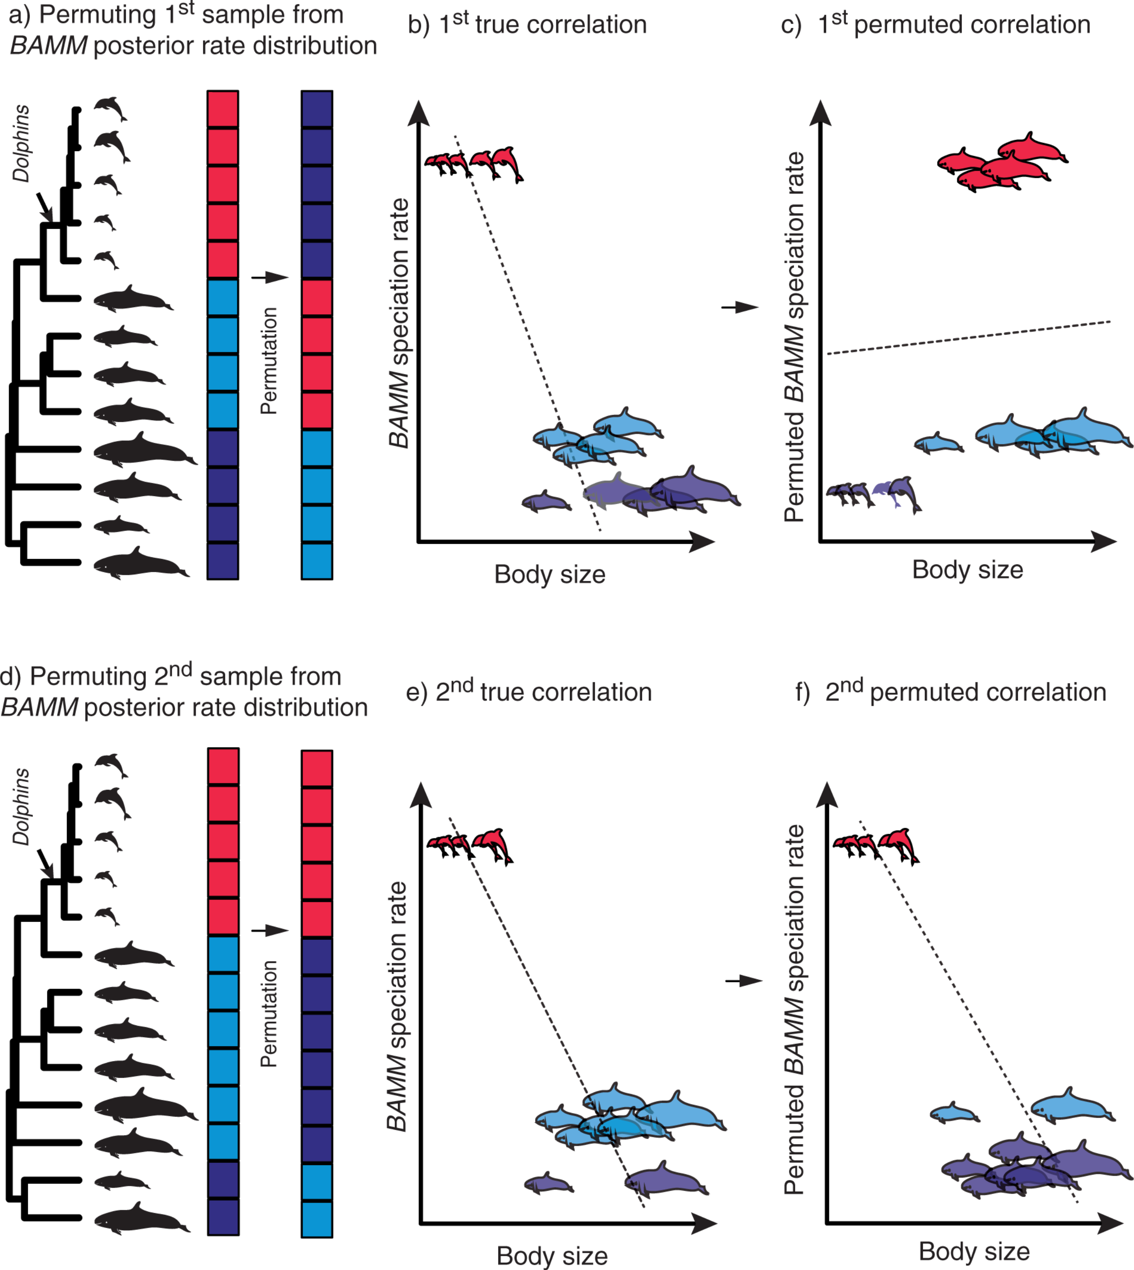
Semi-parametric methods
Randomly sample a BAMM rate regime configuration from the posterior sample
Then calculate the correlation coefficient between diversification rate and character states
Reshuffle the diversification rate regimes and calculate the correlation coefficient again
Calculate how often the correlation for the random reshuffled data is greater than the true data – this proportion is the p value.
Rabosky and Huang 2016

Slide 45
Semi-parametric methods
Always require several transitions
For example if there is only one change in diversification rate and only one character change, even if they are perfectly correlated, the p value will be ~0.5
Found to have lower false positive rates than BiSSE
FiSSE and STRAPP both have low statistical power

Slide 46
Summary
Low statistical power
HiSSE
Hidden state models
Non-parametric methods
FiSSE
GeoHiSSE
STRAPP
Model inadequacy
Phylogenetic pseudoreplication
Parameter hijacking
Confounding effect of transition rates
State dependent models
BiSSE
QuaSSE
GeoSSE
MuSSE
Sister-clade contrasts

